Slide 1
Zoom court session
Information slides for joining zoom
from your desktop computer or laptop

Slide 2
How to join the zoom court session
Enter in your web browser:
www.zoom.us
Then click on “Join A Meeting”

Slide 3
How to join the zoom court session
OR click the link sent in the email you received

Slide 4
Enter the meeting id # provided on your court notice
PM Court Session:
1:00 – Attorney session
2:00 – Self-represented and all other matters
AM Court Sessions:
9:00 – Attorney session
10:30 – Self-represented and all other matters

Slide 5
You may need to allow permission for the zoom application to begin

Slide 6
Once you allow permission, you will be asked to join with computer audio
You will need to click “Join with Computer Audio” to be heard in the zoom meeting.
You can also check the box at the bottom to always join by computer audio in the future.

Slide 7
You’re in! now, make sure you are muted until your name is called

Slide 8
Please change your display name to your first and last name to be easily identified

Slide 9
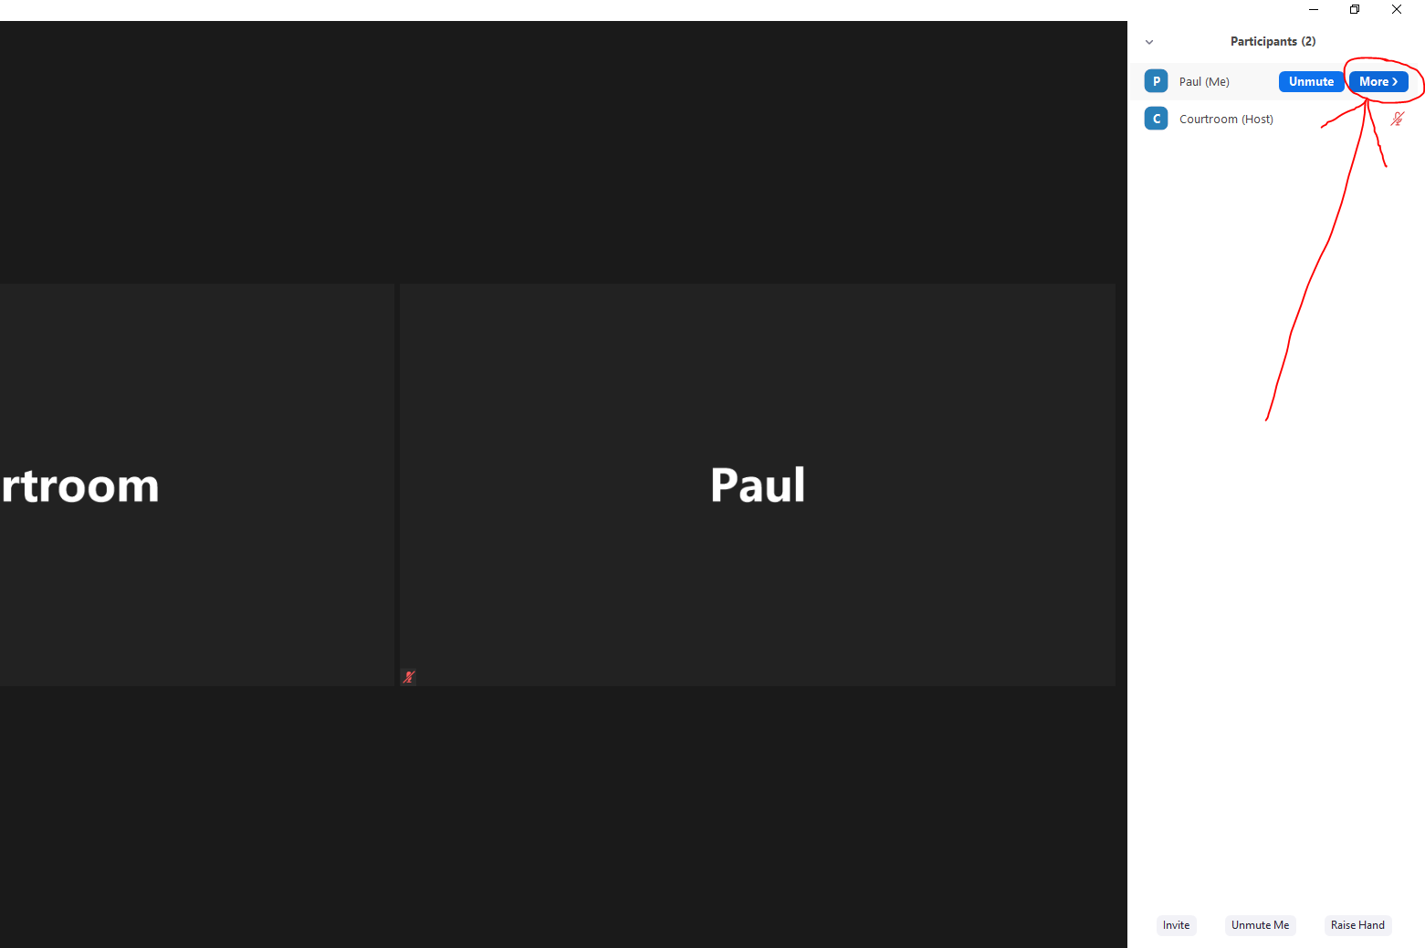

Slide 10
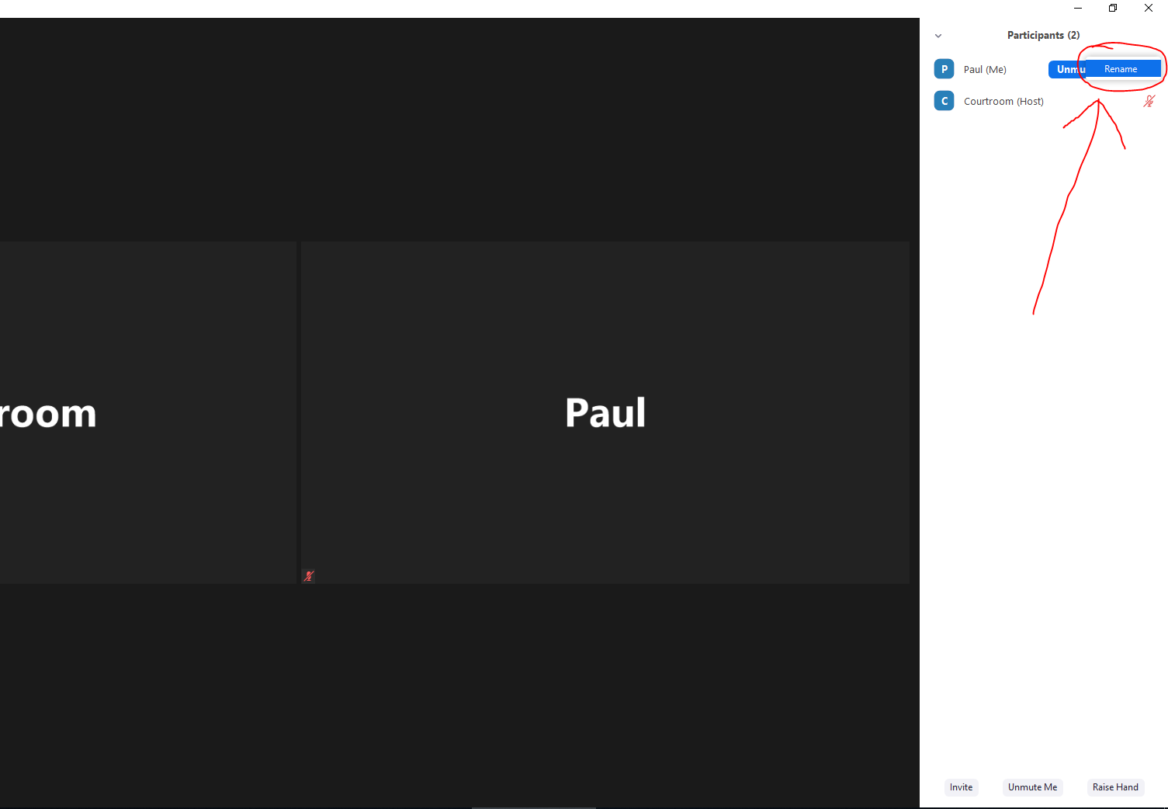

Slide 11
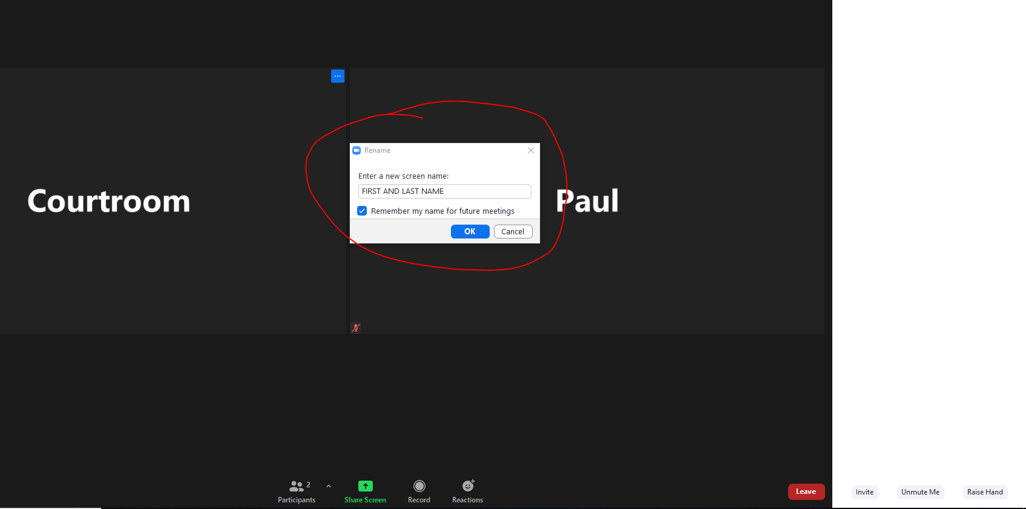

Slide 12
Now, please wait until the judge calls your name to address your case. Thank you!

